Slide 1

Capstone Project:
The Battle of German Cities
Finding the best city to live in Germany
Author: Weilin Liao

Slide 2
Introduction
Recommender systems: An essential role in our daily lives
E.g., Entrepreneurs seek the most suitable place to open a new business.
E.g., Tourists look for a better place to stay for their next travelling destination.
Business problem: Find the best city to live in Germany
Scenario: Lisa, a freelance writer, is looking for a Germany city in Germany for living.
Requirement: A town having a good environment to optimize work-life balance and offering opportunities for leisure activities, she enjoys visiting museums and theatres in her free time.

Slide 3
Data
Data Acquisition
A list of the German cities
Latitude and longitude coordinates of these cities (in order to use latitude and longitude )
Data Source
Simple Maps - Germany Cities Database
Foursquare API (location technology platform)

Slide 4
Methodology
Step1. Data acquisition
Get the list of German cities and their latitude and longitude data from “Simple Maps” (in csv format )and convert it into a data frame.
Step2. Data Pre-processing
Deleting rows having missing data (e.g., rows have no populating data), removing unnecessary columns and modify column names to make the data frame better for analysing.
Step3. Retrieve venue data
Use Foursquare API to retrieve venue data.

Slide 5
Methodology
Step4. Data exploration
Explore the data ncluding grouping the cities to discover how many venues in each city and the number of unique venues each city has.
Step5. One-hot encoding:
Use one-hot encoding to understand the frequency of each venue category’s occurrence.=> Get top 10 most common venues for each city.
Step6. K-Means Clustering
Find the optimal number of cluster and implement K-Means clustering
Use Folium library to plot cities and clusters
Examine different clusters

Slide 6
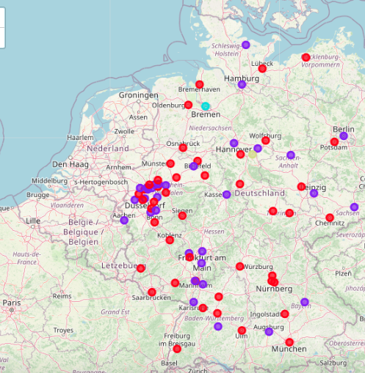
Discussions and results
K-Means Clustering
K = 4 (optimal number of clusters)
Plotting cities on the map in clusters (different colours = different clusters)

Slide 7
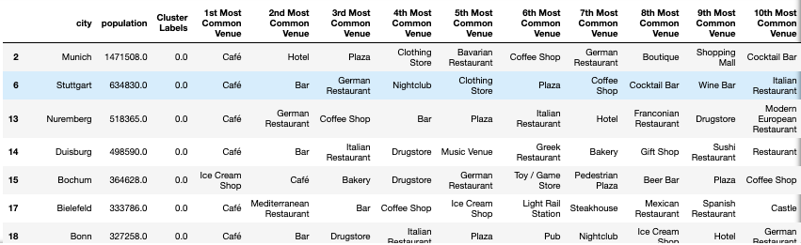
Discussions and results
Cluster 1:
Café, bars, restaurants, shopping (other rows can be found in the report )

Slide 8
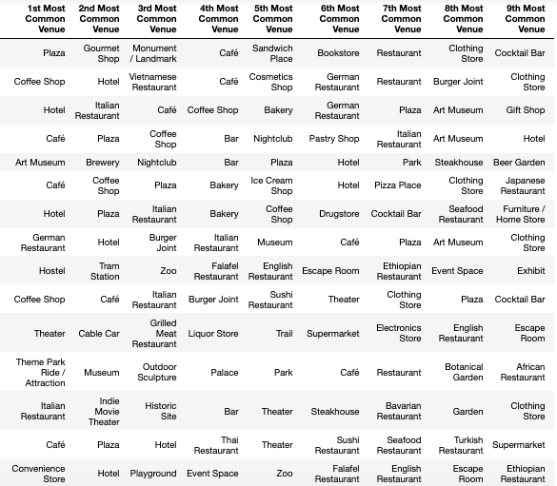
Discussions and results
Cluster 2:
Hotels and leisure (museums, theaters, parks)

Slide 9
Discussions and results
Cluster 3: Event places, soccer fields

Slide 10
Discussions and results
Cluster 4: Event places, intersections

Slide 11
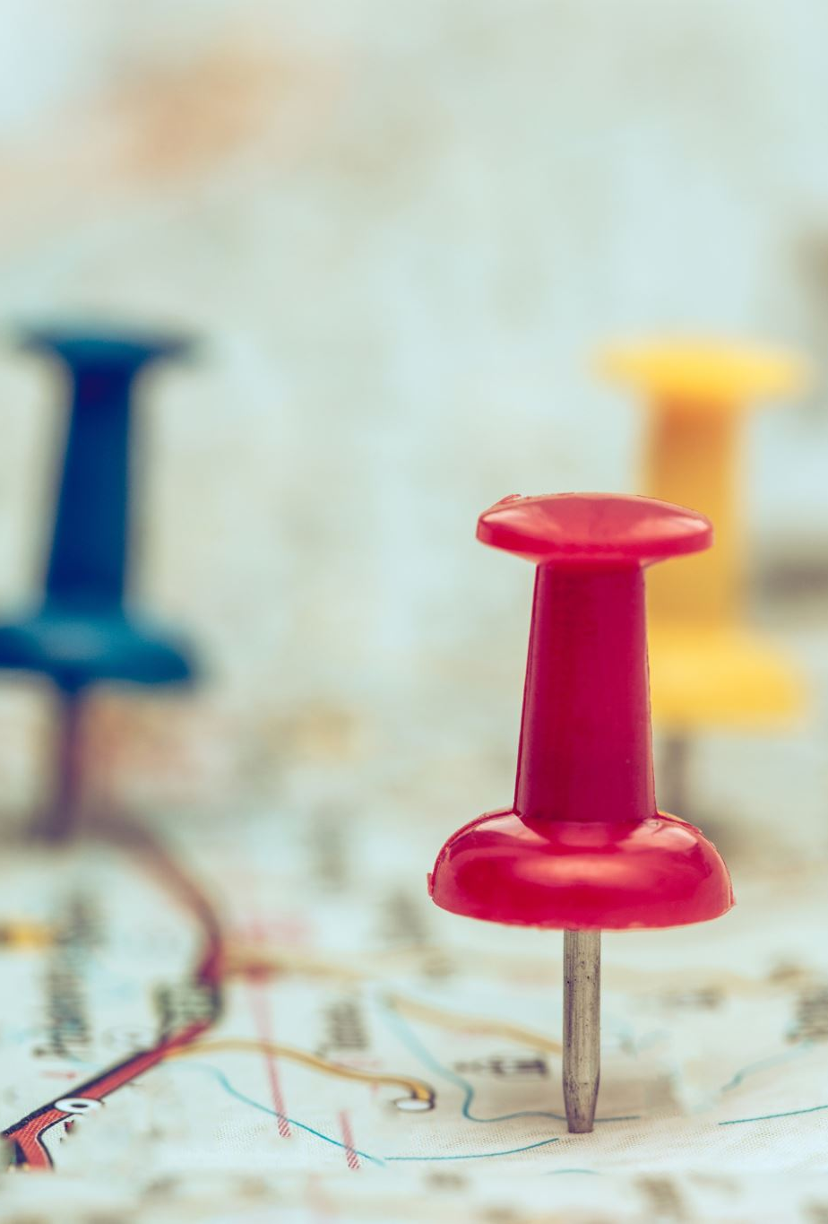
Conclusion
Cities in Cluster 2 are recommended for Lisa to move to
Cities in cluster 2 have:
Parks: work-life balance optimizations
Facilities for leisure activities (e.g., museums and theatres)
Cities in cluster 2 :
Berlin, Hamburg, Cologne, Frankfurt, Düsseldorf, Dortmund, Essen, Dresden, Leipzig, Hannover, Wuppertal, Karlsruhe, Augsburg, Wiesbaden, Mönchengladbach, Gelsenkirchen, Braunschweig, Kiel, Aachen, Magdeburg, Oberhausen, Kassel, Ludwigshafen, Mülheim, Heidelberg, Darmstadt, Herne, Regensburg, Reutlingen, Bergisch Gladbach, Moers, Cottbus, Gütersloh.

